Slide 1
Intel - Final Presentation
Project Title : Searching a Video Database using Natural Language
Queries
Project Guide : Dr. Mamatha H R
Project Team : Shubha M (PES1201701540),
Shrutiya M (PES1201700160),
Kritika Kapoor (PES1201701868)

Slide 2
Project Abstract and Scope
Voice based natural language query
Search and extracted video segment playing
USES
Visual Features Based
Audio Based
A red car in front of a white building.
(Security footage database)
Man in a blue jacket next to a woman.
(Can be used in journalism for identification)
Ball in goal post.
(Sports events video databases)
Derivation of Naive Bayes
(College lecture videos)
May the force be with you
( Dialogue in a TV show episode or a movie)

Slide 3
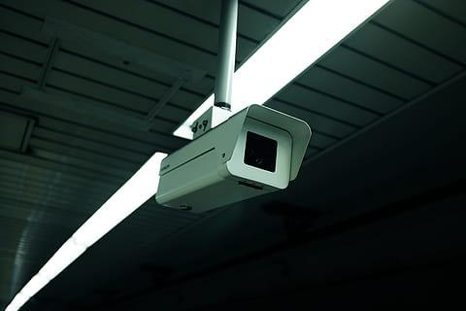
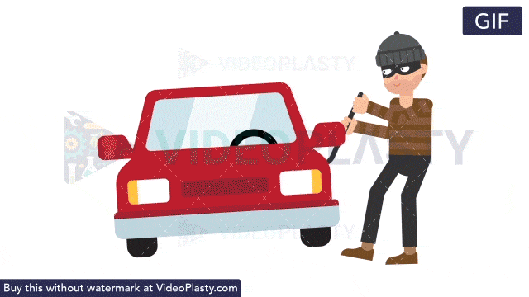
Project Abstract and Scope
Scenario 1 - CCTV capturing a criminal trying to steal car parts
Voice query
Man approaching red car
INPUT
OUTPUT
CCTV Footage
Appropriate segments from the CCTV where the cart parts are being stolen

Slide 4
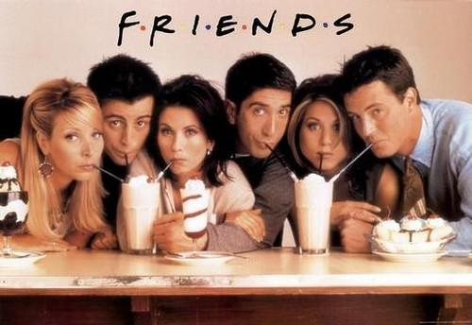
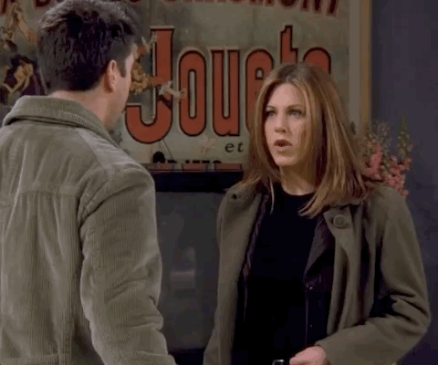
Project Abstract and Scope
Scenario 2 - A scene from an episode based on a dialogue
INPUT
Voice query
OUTPUT
One episode from ‘F.R.I.E.N.D.S’
Segments from the episode showing the epic scene
We were on a break

Slide 5
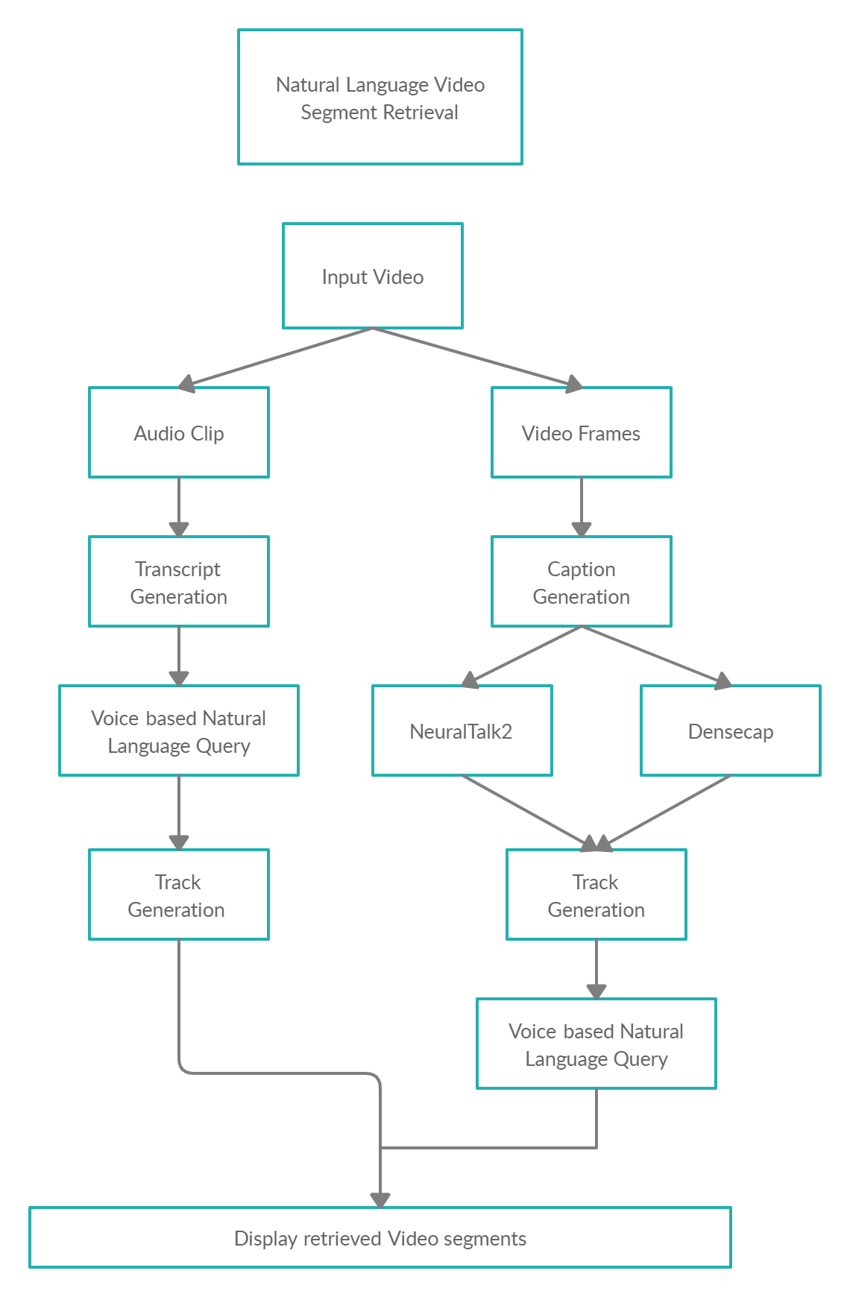
Model

Slide 6
Design Approach
Visual Approach:
Two different image captioning models: Densecap and NeuralTalk2.
It consists mainly of 3 sequential parts:
GENERATE CAPTIONS
CREATING TRACKLETS
VOICE BASED SEARCH
Video frames
NeuralTalk2 and Densecap applied
NeuralTalk2: Caption sequence considered.
Densecap: N tracklets started, M matched, N-M new making total 2N-M tracks.
Semantic Similarity, Cutting Threshold and Spatial Similarity (Densecap) considered.
Speech Recognition for voice to text.
Google’s Universal sentence Encoder followed with cosine similarity

Slide 7
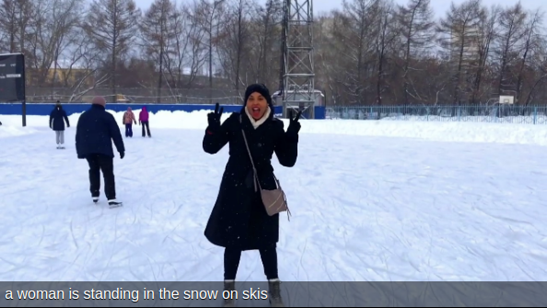
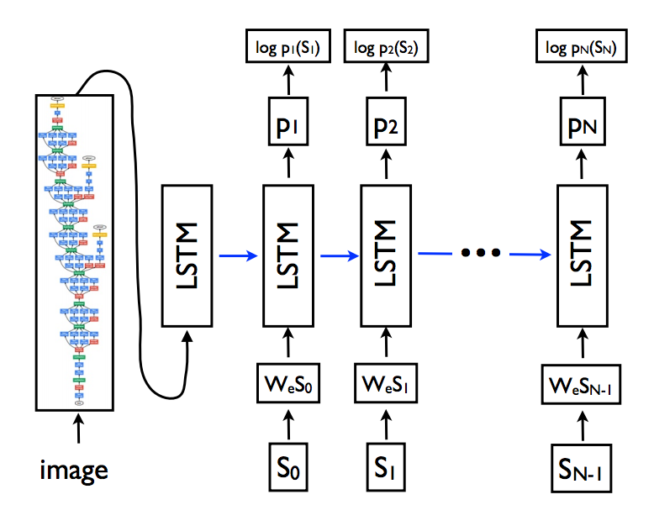
NeuralTalk2
NeuralTalk2 generates one appropriate caption per image.
Example of NeuralTalk2 output
Architecture
Notes:
‹#›

Slide 8
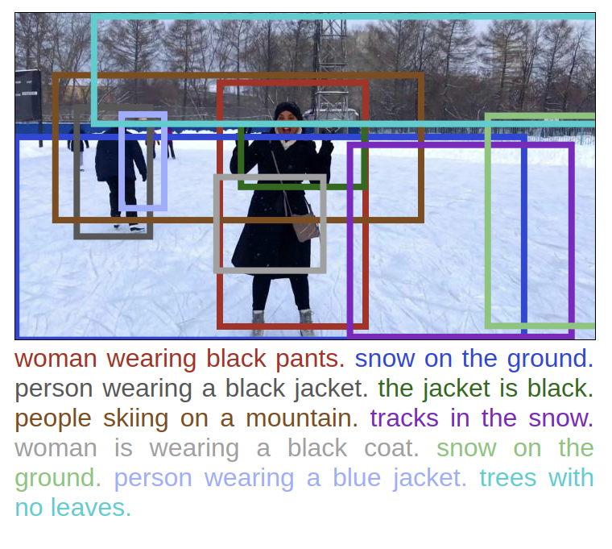
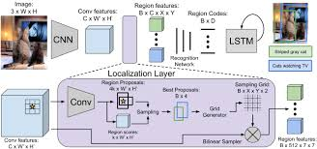
Densecap
Densecap generates multiple captions corresponding to specific regions of interest, denoted by bounding boxes, in the image.
Architecture
Example of Densecap output
Notes:
‹#›

Slide 9
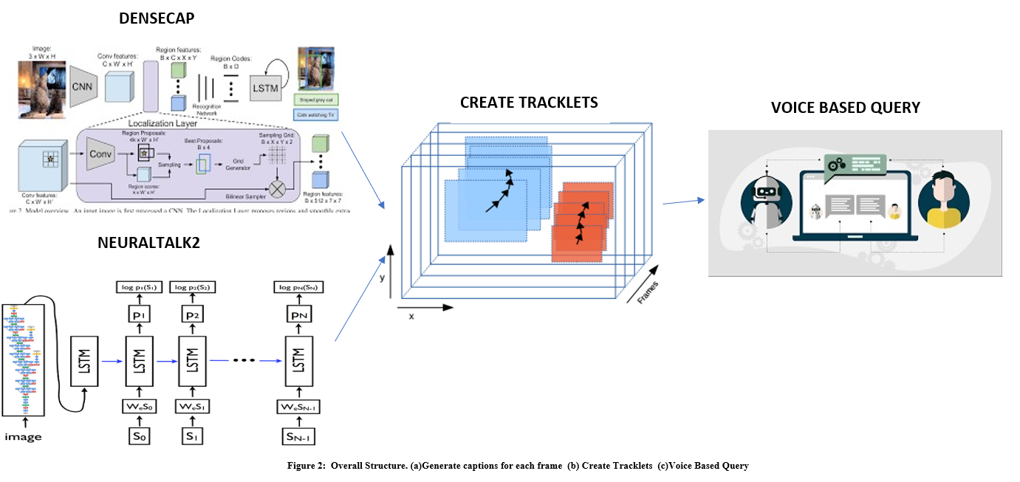
Design Approach
Video Approach Model:
Notes:
‹#›

Slide 10
Design Approach
Audio Approach:
Transcript Generation
Voice Based Query and Track Generation
Display Video Segments
Process the transcripts generated by YouTube for a particular video store with their start and end timings
Query followed by on-the-fly generation of tracks
Cutting threshold set to get end of segment
Merging if required.
Retrieved video segments shown on the original video, so the the user can either choose to continue or could navigate to before or after the specified video segment.
Notes:
‹#›

Slide 11
Future Scope
Caching (or storing in a DB):
The retrieval rate in Audio approach for a 49 minutes video is around a day for a given query. These results can be cached. Caching can drastically increase the performance for repeated queries.
Since this approach is used mainly for lecture videos, the results for common keywords can be cached. This would make retrieval rate for them way faster.
A web portal can be developed for displaying the results. Right now the results are shown on CLI.
The demo is right now showed for particular videos. This can be extended to a complete database.

Slide 12
Appendix
Detailed Design Approach
Benefits and Drawbacks
Other efforts in Image Captioning(not employed)
Demo and Results
Literature Survey
Summary
Notes:
‹#›

Slide 13
Design Approach
We have two design approaches , one considering the visual features and the the other considering audio features of the video.
Visual Approach:
The architecture is designed using two different image captioning models Densecap and NeuralTalk2. It consists mainly of 3 sequential parts:
i. Generate Captions
ii. Creating Tracklets
iii.Voice based Search.
Generating Captions
Splitting the video clip into frames.
After this, the image captioning models were applied on each frame.
NeuralTalk2 generated one caption whereas Densecap generated multiple captions corresponding to specific regions of interest, denoted by bounding boxes, in the image.
Notes:
‹#›

Slide 14
Design Approach
2. Creating Tracklets
The creation of tracklets vary for the NeuralTalk2 and Densecap approach.
a. NeuralTalk2 -
The first tracklet is represented by the caption of the first image and the rest of the frames are sequentially compared with the tracklet upto the previous frame.
The criteria of inclusion of a frame is the semantic similarity exceeding the threshold.
Completion of tracklets is achieved by the number of frames calculated to be dissimilar to the tracklet caption exceeds the cutting threshold.

Slide 15
Design Approach
b. Densecap -
It outputs a json file, with 80 captions(avg.) per image mapped with the corresponding weights, and bounding boxes of the objects.
If frame has N captions, N tracklets are begun each represented by these captions. A new frame is compared, and if M captions are found to be similar, the unmatched N-M captions are registered as new tracklets, resulting in the total of 2N-M tracklets.
First 5 highest weight captions are used.
Semantic similarity threshold and cutting threshold concept is used here too to continue the process.

Slide 16
Design Approach
The euclidean distance of the bounding boxes of two frames is used to decide spatial similarity.
This generates a set of tracklets each represented by the caption of the first frame, and each tracklet storing information of the frames it constitutes.
Given an input video, it is processed upon by both of these methods and broken down into a set of tracklets.
After this the duration of every tracklet was calculated by mapping it to the input video duration and this data was stored in a file.

Slide 17
Design Approach
3. Voice based Query
The input voice query is converted to text using a speech recognition system
The query is compared with every representative caption of the final tracklets and outputs the tracks that are semantically relevant.
Google's Universal sentence-encoder is employed. Using a word based embedding approach and obtaining average of word embedding will mostly not represent the actual meaning of a sentence.
Finally, cosine similarity metric is used as the similarity measure.

Slide 18
Design Approach
Audio Approach:
Scope and Uses of this approach:
This acts as an added approach to creating tracklets as audio might be important in certain situations and can provide vital information to tracklet formation.
This can be used on all videos with audio to seek to the part where anything related to the given query was present (Semantically similar).
A very useful example would be a College lecture video. By giving a keyword as the query, we can retrieve the video segments of a huge video where that or anything similar to that is being explained.

Slide 19
Design Approach
Procedure:
For this approach, we process the transcripts generated by YouTube for a particular video and first store all the transcripts with their respective start and end timings
The voice query is taken as input and the most relevant segments of the video are retrieved using a on-the-fly generation of tracks. A cutting threshold of a predefined value is used after which that particular track terminates and the end time is stored. The algorithm continues to find other tracks relevant to the query.
Now that we have the start and end timings of all the relevant tracks, merging of consecutive tracks is done if they are supposed to be continuous, based on predefined threshold.
Finally the retrieved video segments are shown on the original video, so the the user can either choose to continue or could navigate to before or after the specified video segment.

Slide 20
Benefits and Drawbacks
Benefits of the approaches used:
Video Approach:
Most of the video data models built so far are usually content and rule based, wherein objects are detected using bounding rectangles and are primarily used for querying event based and spatial relations. These are usually application specific and domain dependent, and which require certain level of annotation.
The model prescribed by us does not need annotation of the video database. Instead image captioning tools are employed to extract information about the objects and events through deep neural networks. This information is used for querying which makes our model domain-independent and serves general purpose.
Audio Approach:
This can be used on all videos with audio to seek to the part where anything related to the given query was present (Semantically similar). Eg: College lecture video.

Slide 21
Benefits and Drawbacks
Drawbacks:
1. Neuraltalk2
There is lesser localization as the whole track is formed on the basis of a caption. The spatial relations between the objects in the frames are not given importance.
2. Densecap
Tracklets formed can be extremely small.
3. Audio Approach
As semantic similarity is the base for forming tracklets, results might not be accurate as other factors in the time domain and frequency domain also need to be considered.

Slide 22
Design Approach
Other efforts in Image Captioning(not employed):
We built our own Image captioning model, training it on the Flickr8k dataset, employing a CNN-RNN model.
Our Model comprises of two basic components:
Convolutional Neural Network: This is used for extracting the most important features of the input image, breaking down an image of size 224*224*3 into a vector of 1*4096 recognizable features.
Recurrent Neural Network: Input to this component of the model are the features, in which we implement LSTM cells, an improvised concept of RNN involving memory. Input to the cell at time step t will be the caption predicted at time step t-1 and the weights are accordingly adjusted to produce the most probable word keeping the embeddings into consideration.

Slide 23
Design Approach
Other efforts in Image Captioning(not employed):
Algorithm -
From the available captions, vocabulary is formed by setting a
threshold on the frequency of the words, hence forming a vocabulary
of 996 words.
Each word is mapped into a 256 dimension vector, to represent words
with a bigger space.
The input image is mapped into a word space to provide appropriate
input to the LSTM cell, which forms the input for the first time step.
As the loop progresses, to predict the next word, the embeddings of the
previous word are passed to the LSTM.
Finally, at the end of every epoch, we calculate form a mask vector
taking care of how many words are used in the caption and also form
a one-hot encoding for the words.
Then these features are encoded back into words, Caption is generated
using a naive greedy approach.

Slide 24
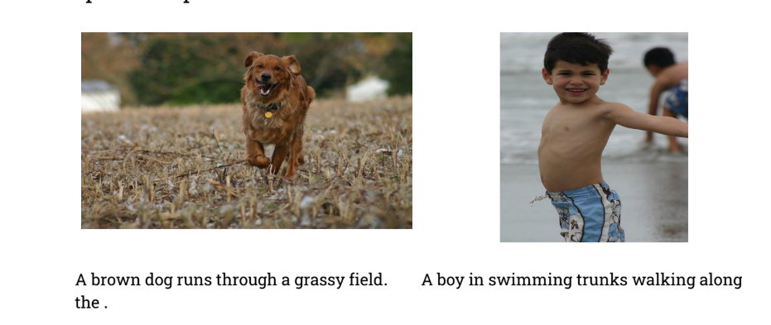
Design Approach
Other efforts in Image Captioning(not employed):
Results of this approach -
But since this model wasn’t performing that well, we decided to go ahead with pre-built image captioning models such as Densecap and NeuralTalk2.

Slide 25
Any obstacles/challenges
The application of video retrieval requires a lot of computational power. NVIDIA CUDA enabled GPU was used for better computational abilities. GPU enabled DenseCap and NeuralTalk2 implemented in Torch are used to generate the captioning of the frames.
The program to create tracklets was run on Google Colab. However just running 10 frames took about 4 hours. And the video we had had 1950 frames. We found a hack to enable 35gb ram TPU. We then decided to divide the entire task into smaller tasks to get intermediate tracks and then later merge them. However, it was still not very feasible with the resources we had.
Colab is ineffective as it continuously keeps disconnecting, and since the final requirement is to process more than a single video, colab would be very inefficient. Hence current model is run on a 1 minute video for demo.

Slide 26
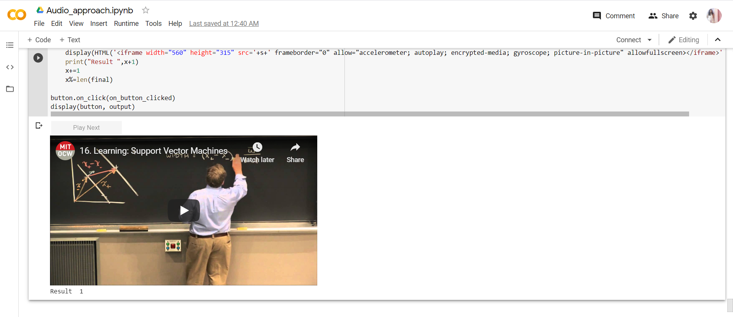
Demo and Results
Interface Screenshots:
Audio Approach Results
Notes:
‹#›

Slide 27
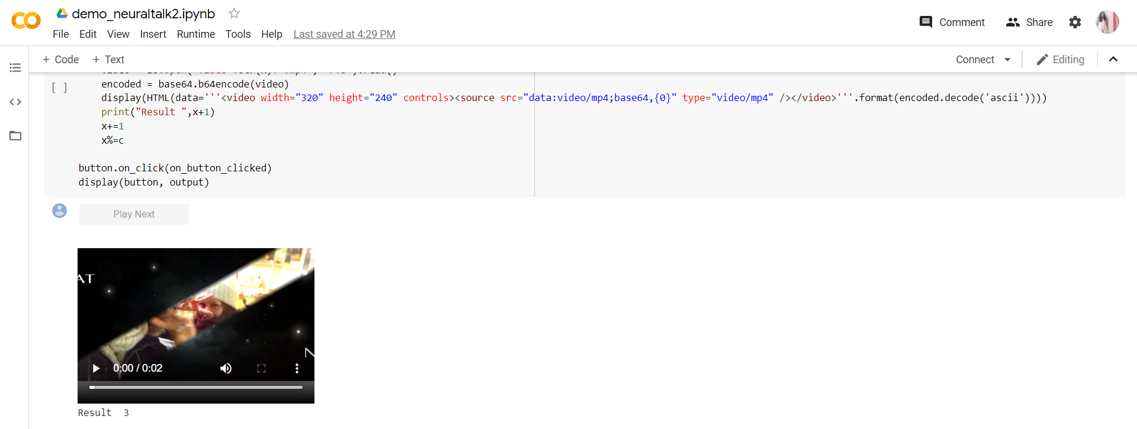
Demo and Results
Interface Screenshots:
NeuralTalk2 Results
Notes:
‹#›

Slide 28
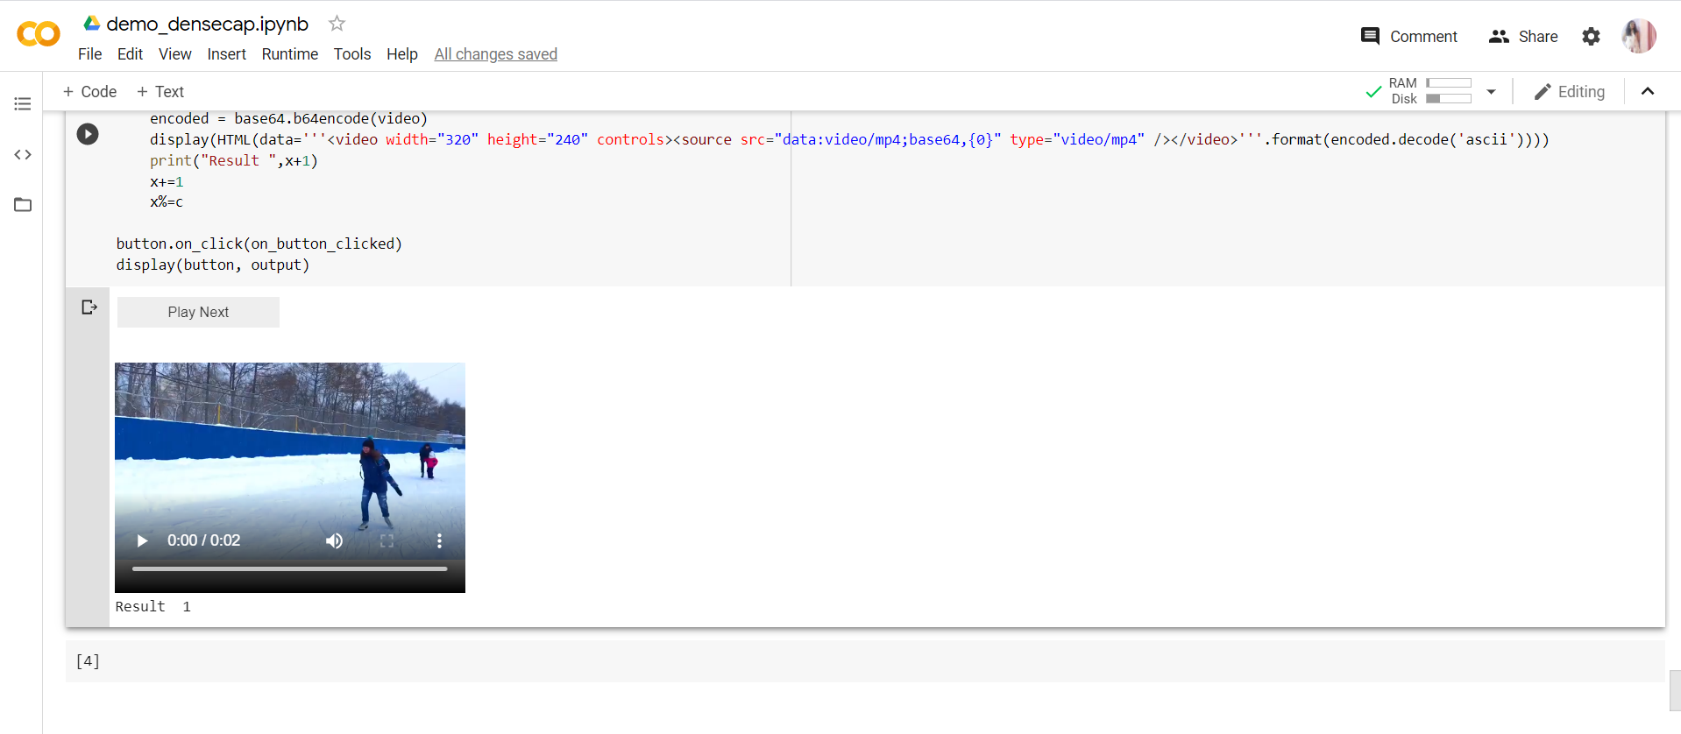
Demo and Results
Interface Screenshots:
Densecap Results
Notes:
‹#›

Slide 29
Demo and Results
Video Approach:
Tested on a one minute video. The number of frames generated was 519 (using opencv).
The similarity threshold in constructing semantic tracklets varied from 0.6 to 0.8.
Time taken to find similarity between two sentences was approximately 12 seconds. The cutting threshold was set to 5 frames, and the minimum track size was also set to 5 frames.
A set of tracks with representative caption was proposed.
Retrieval Rate : around 17 minutes (NeuralTalk2)
around 3 hours (Densecap)
Padding was added to the retrieved videos if less than one second.
Notes:
‹#›

Slide 30
Demo and Results
NeuralTalk2 Approach
Video:https://youtu.be/rnQLGLvlSIQ
Voice query: “a woman is skiing” Outputs:
https://youtu.be/HuUamlDneSg
https://youtu.be/HigfoDnZsbY
https://youtu.be/t-U2jXjfzik
Notes:
‹#›

Slide 31
Demo and Results
Densecap Approach
Video:https://youtu.be/rnQLGLvlSIQ
Voice query: “a woman is skiing”
Outputs:
https://youtu.be/g14sERx98qw
https://youtu.be/lq9eHwS6Uq4
Notes:
‹#›

Slide 32
Demo and Results
Audio Approach:
Tested on a 49 minute youtube lecture video on SVM by Patrick Winston. The number of transcripts generated was 868.
The similarity threshold in constructing semantic tracklets was set to 0.6.
Time taken to find similarity between two sentences was approximately 12 seconds. The cutting threshold was set to 2 transcripts, and the minimum track size was also set to 7 seconds.
Different set of tracks relevant to the input query was proposed.
Retrieval Rate : One day
Notes:
‹#›

Slide 33
Demo and Results
Audio Approach
Video:https://youtu.be/_PwhiWxHK8o
( Support Vector Machines by Instructor : Patrick Winston )
Voice query: “constraint”
Outputs:
https://youtu.be/_PwhiWxHK8o?start=462&end=548
https://youtu.be/_PwhiWxHK8o?start=831&end=876
https://youtu.be/_PwhiWxHK8o?start=1045&end=1055
https://youtu.be/_PwhiWxHK8o?start=1134&end=1149
https://youtu.be/_PwhiWxHK8o?start=1355&end=1604
https://youtu.be/_PwhiWxHK8o?start=1849&end=1881
https://youtu.be/_PwhiWxHK8o?start=2058&end=2115
https://youtu.be/_PwhiWxHK8o?start=2313&end=2380
Notes:
‹#›

Slide 34
Literature Survey
Several studies related to this have been published. Many video data models are concept based and have an object oriented approach.
BilVideo
Uses POS tagging information to group the specified queries as object, spatial, and trajectory queries.
Uses the knowledge base and object-relational database to provide the results.
Has a visual interface (Web-based) for query specification unlike our natural language interface. Natural language querying interface is more desirable than other forms of interfaces since it provides more flexibility where the user can use his/her own sentences for querying.

Slide 35
Literature Survey
2. Natural language querying for video databases, Information Sciences
Content-based video data model for spatio-temporal and trajectory based queries.
It uses the semantic content which includes objects, activities, events and spatial properties of objects.
Information extraction techniques used to extract the semantic representations of the queries. This is used to query the object database.
Conceptual ontology module is implemented with WordNet. This uses word based embeddings which may not extract the complete meaning of the sentence.
However, both these systems majorly require structured models to relate to the objects/concepts from the video database based on certain rules which makes the application specific to certain cases only and less general purpose.
But on the other hand, using natural language to describe an image using deep neural networks provides a good language model to extract information from the images.

Slide 36
Literature Survey
3. Person search with natural language description
Tackles the problem of searching a person in huge image databases using natural language based description.
References NeuralTalk2 that uses RNN with Gated Neural Attention mechanism (GNA- RNN).
Is used for an image and hasn’t tackled the problem of video segment retrieval. But these methods can be easily extended to work with videos and forms the crux of our attempt.
4. Where to Play: Retrieval of Video Segments using Natural-Language Queries
Uses Densecap to generate multiple captions per image and conducts a tracking by caption to retrieve video segments.
Densecap is a model whose architecture consists of a CNN, a dense localization layer, and an RNN language model that produces the labels.
Uses Skip-thoughts vector for sentential encoding and for performing semantic similarity.

Slide 37
Summary
For the given problem statement we present two broad approaches, Audio and Video approach to retrieve video segments for a given video.
The Video approach is performed using two image captioning techniques namely being Densecap and NeuralTalk2. This approach mainly had 3 different phases:
i. Generate Captions
ii. Creating Tracklets
iii.Voice based Search.
Audio approach mainly consists of Transcript generation, voice based query and Track generation on fly and results displayed after merge and filter
The model performs appreciably well on the inputs provided and tests performed.
Notes:
‹#›

